Slide 1

House Price Prediction
Group 5
Pranit Sadaphal
Mayur Kusmade
Om Gaikwad
Kartik Mujmule
Shahebaj Pathan

Slide 2
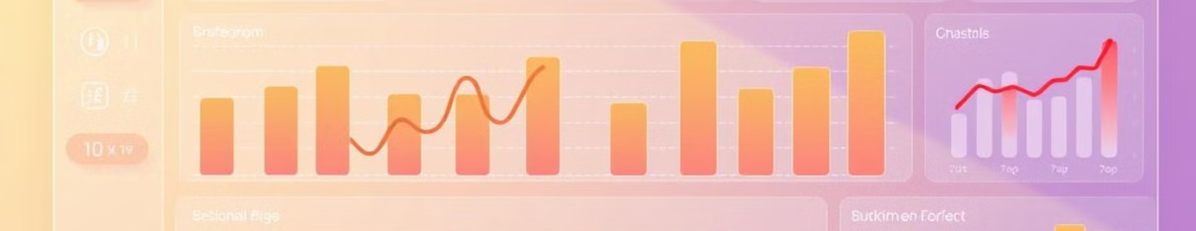



Project Goals
Accurate Estimations
Machine Learning
Precise Valuation
Develop an accurate house price estimation model.
Leverage machine learning regression techniques.
Achieve precise property valuation.
Our project's key objective is to analyze influential housing features to predict prices.

Slide 3
Data Insights
Input Features
Data Sources
Square footage
Real estate databases
Bedrooms
Public property records
Bathrooms
Number of floors
We focus on data preprocessing and feature engineering to improve model accuracy.

Slide 4




ML Approaches
Linear Regression
Random Forest
Gradient Boosting
We use Linear Regression as a baseline model and explore advanced techniques. Cross-validation is key for assessing model performance and hyperparameter tuning.

Slide 5
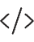


Implementation
Python Based
Using Python-based machine learning framework
Libraries
Leveraging scikit-learn, pandas, numpy
Jupyter
Model development in Jupyter Notebook
Our approach is scalable and reproducible for consistent results. We ensure all code is well-documented.

Slide 6

Real-World Impact
Market Analysis
Investment
Real estate market analysis.
Property investment decision support.
Automated Valuation
Automated valuation for financial institutions.
We aim to develop a tool for individual homebuyer price estimation. This supports financial planning.

Slide 7




Future Steps
Algorithms
Integrate machine learning algorithms.
Expand Features
Add external data sources.
Interactive Interface
Develop an interactive prediction interface.
We plan continuous model refinement and learning. Our goal is to improve prediction accuracy.

